Slide 1

Python Course Chapter 12
Introduction to Web Scraping

Slide 2
Web Scraping
Web scraping is a general term for techniques involving automating data gathering from a website. The idea is that we can use python to search in HTML code and find whatever resources we want.
Things to Know about Web Scraping:
Always try to get permission before scraping if you can. Not all websites would allow you to do web scraping on their website.
Sending too many HTTP requests to make web scraping may result in making your IP address blocked.
Some websites block web scraping software.

Slide 3
Web Scraping
Each website has different HTML codes. That means, if we want to do web scraping for a different website, then we need to write new codes.
Websites update their own HTML codes sometimes. Therefore, our web scraping Python codes might not work anymore after the update. We need to look at the HTML code’s changes, and change our Python codes accordingly.

Slide 4
Web Scraping
Even though web scraping has many restrictions and limitations, it’s still a useful tool. For example, we might scrape product information from an e-commerce website onto an excel spreadsheet. Although we can do many tasks manually, it might be better off to use an automated tool in most cases.
Python is not the only programming language to do web scraping. We might use Java or JavaScript to do web scraping as well. However, Python web scraping syntax is the easiest to learn and fastest to write, so Python is the most popular language to do web scraping!

Slide 5
HTTP, HTTPs, and HTML
HTTP stands for Hypertext Transfer Protocol. HTTP is the foundation of any data exchange on the Web. A simple way to understand HTTP is to think of HTTP as an agreement of the whole world; an agreement that specifies how data should be transferred on the internet.
The letter s in HTTPs stands for secure. All data are encrypted by the RSA algorithm; therefore, your private information, such as bank account number, won’t get hacked during the data transfer. When we go to the URL https://www.youtube.com, we send an HTTP request to YouTube’s server.

Slide 6
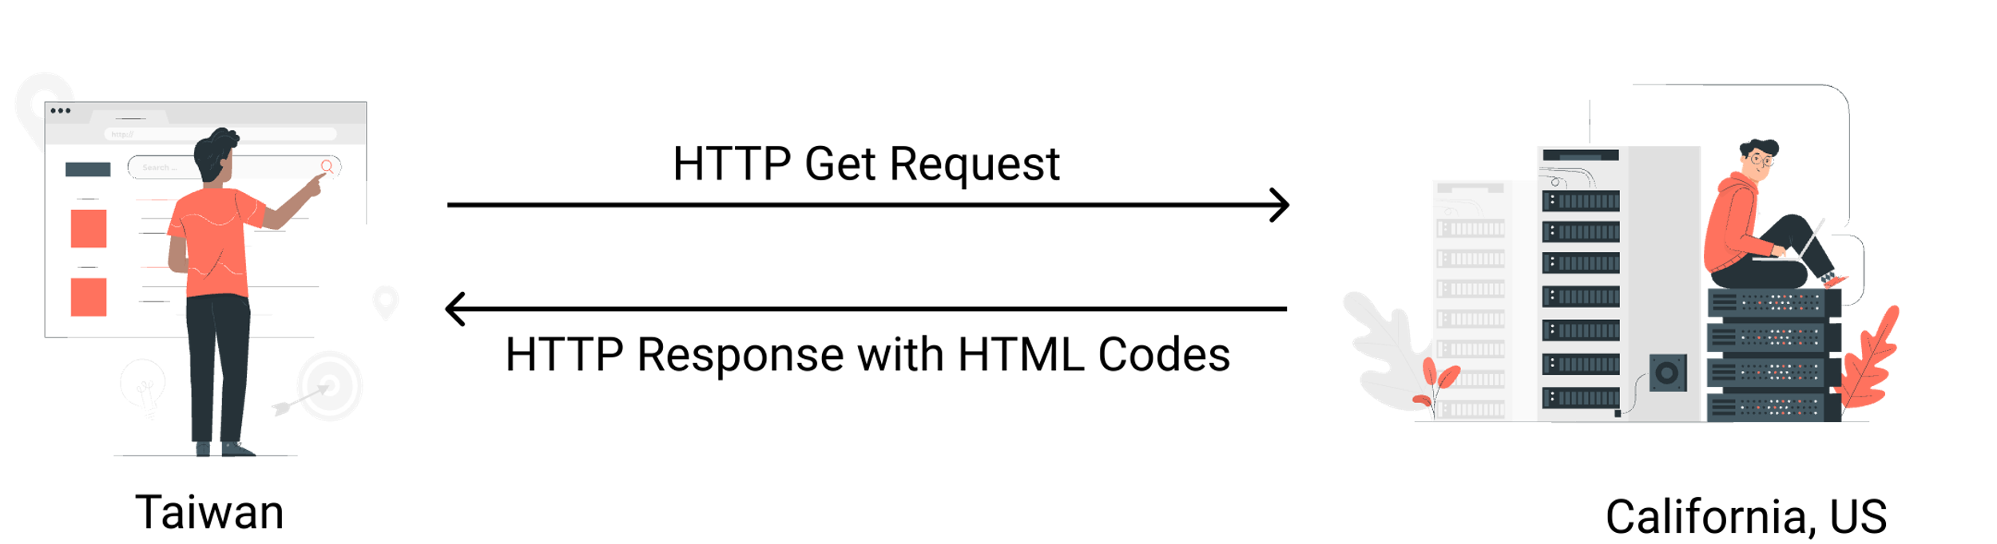
HTTP, HTTPs, and HTML
YouTube’s server gets our HTTP requests, and it will send an HTTP response, including HTML codes in there. Our browser receives the HTTP response, parses the HTML codes from YouTube, and displays it nicely on our screen.

Slide 7
HTML Basics
You don’t have to be a web development master to do web scraping. We will just learn the basics here. Of course, the more you know about HTML, the better it is for you to do web scraping.
HTML (HyperText Markup Language) is the most fundamental building block of the Web. It defines the meaning and structure of web content. HTML uses "markup" to annotate text, images, and other content for display in a Web browser.
Each HTML page consists of 2 parts – head and body; this is called the HTML Skeleton.

Slide 8
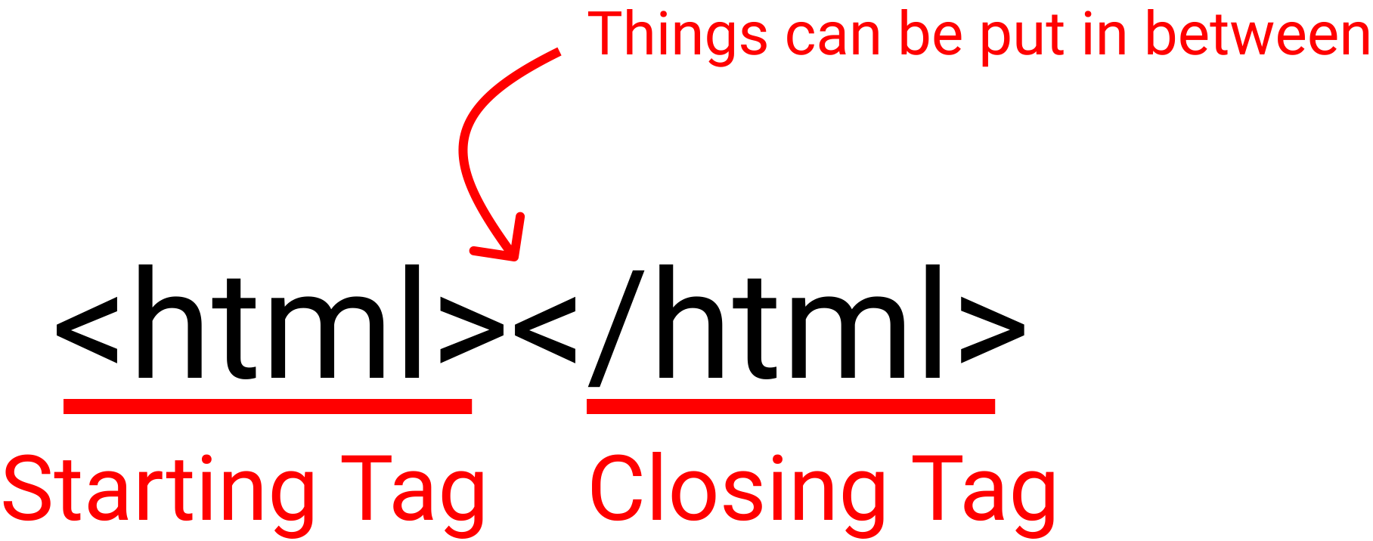
HTML Basics
The HTML skeleton is:
<!DOCTYPE html> <html> <head></head> <body></body> </html>
The DOCTYPE stands for the document type. Each HTML tag consists of 2 parts – starting tag and the closing tag.

Slide 9
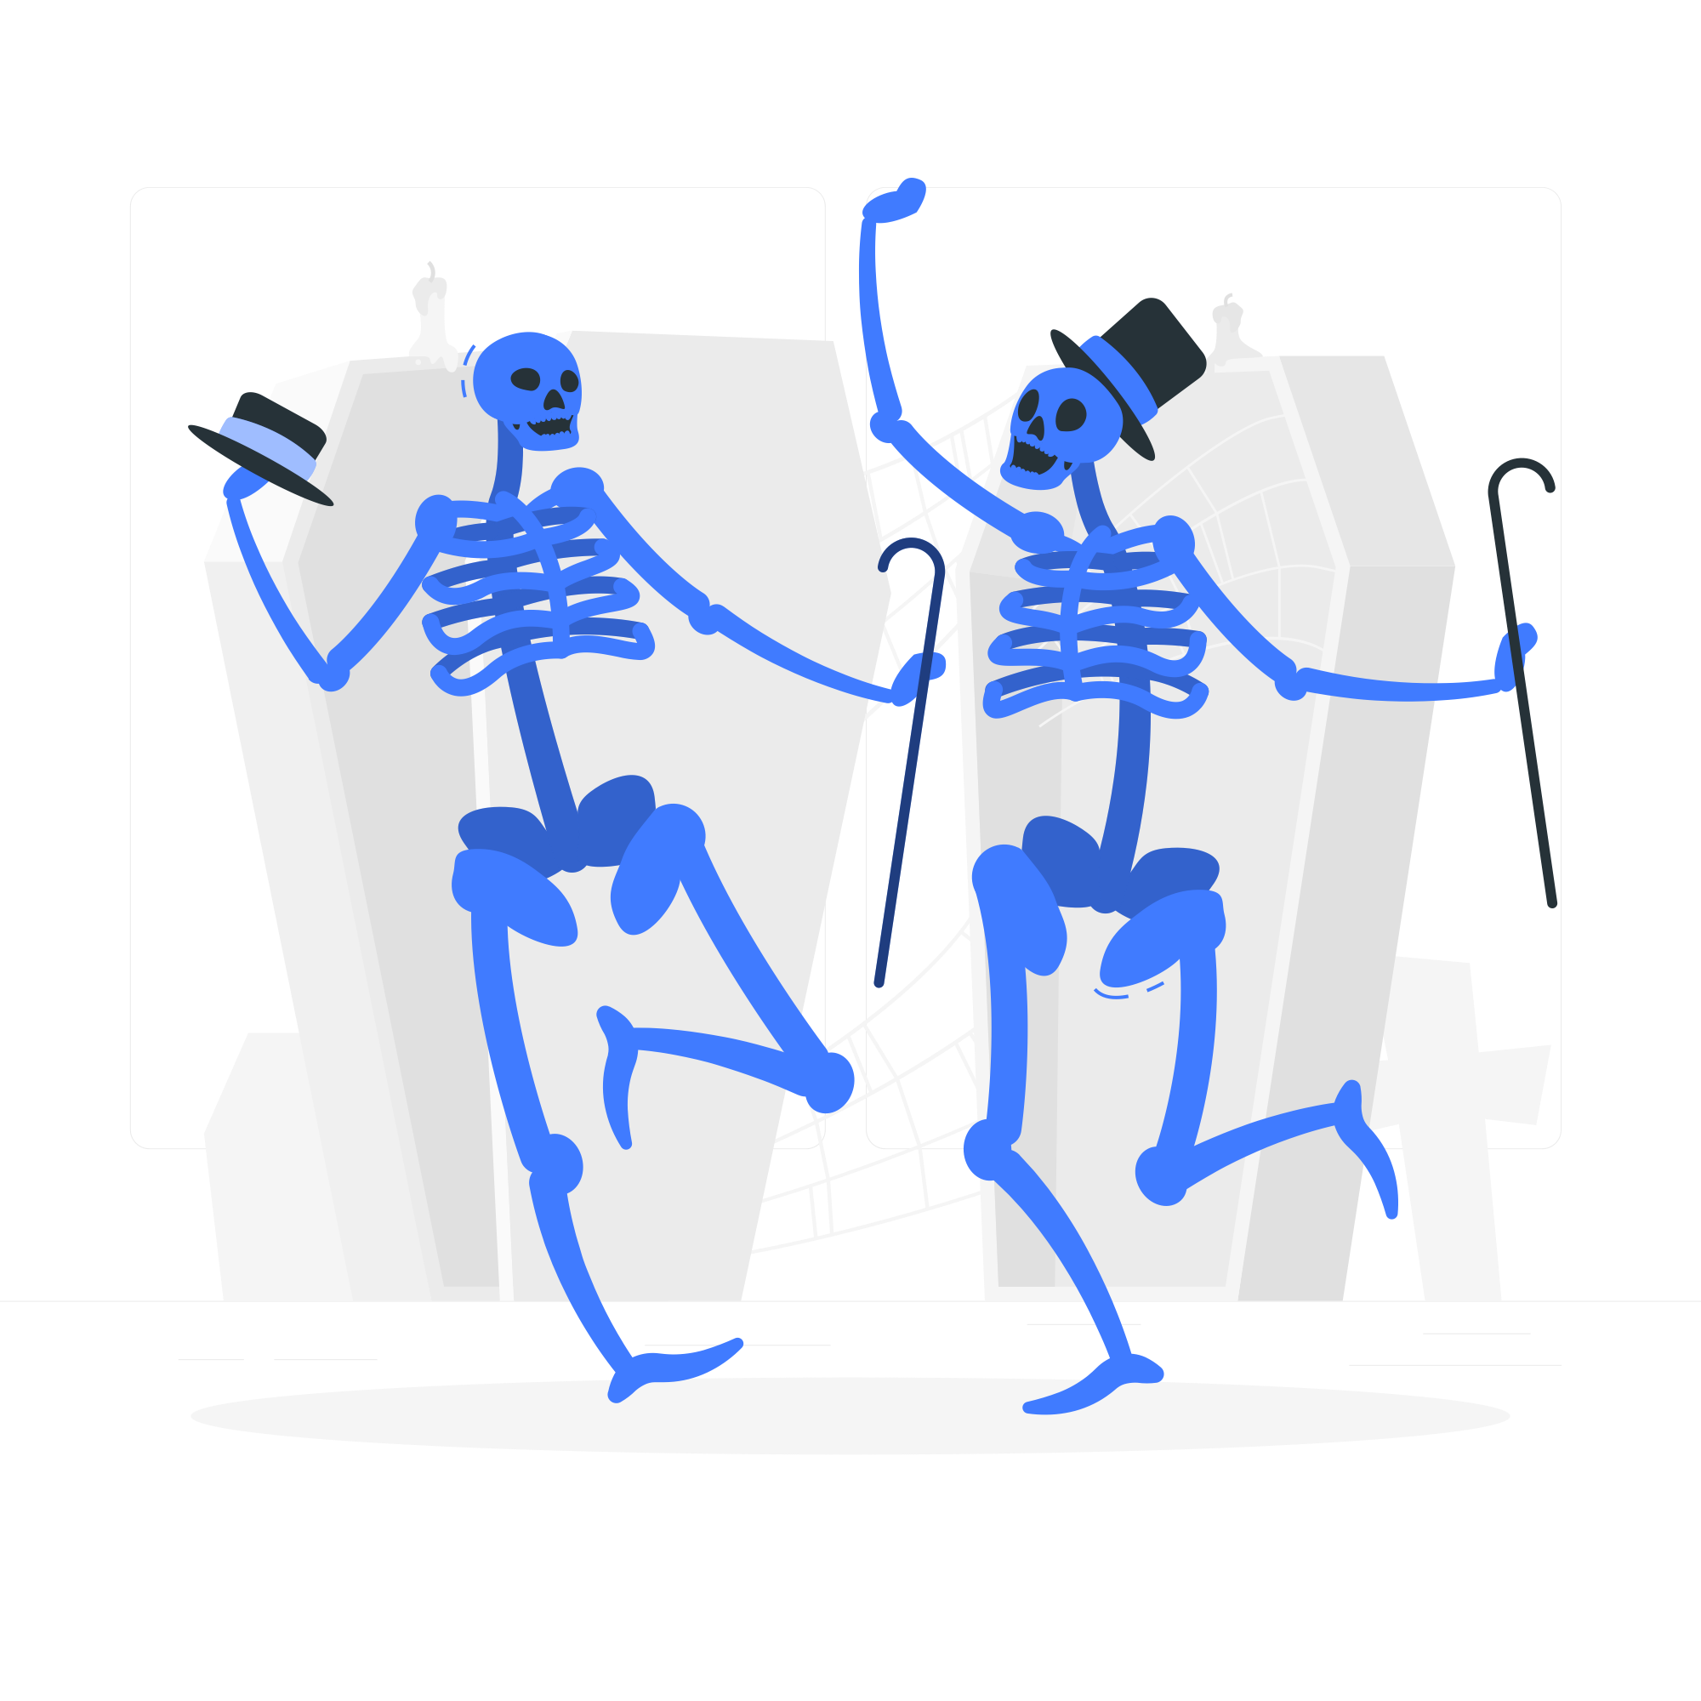
HTML Basics
The <html> tag represents the root of an HTML document. The <head> tag in HTML is used to define the document's head portion, which contains information related to the document, such as title, meta, and style.
The webpage-related information is defined in the head tag, and webpage content is defined in the body tag.

Slide 10
HTML Basics
Here’s what a typical head tag look like:
<!DOCTYPE html> <html> <head> <meta charset="UTF-8" > <meta name="viewport" content="width=device-width, initial-scale=1.0" /> <title>Document</title> </head> <body></body> </html>
The <meta> tag defines the metadata of the webpage, such as encoding and viewport size. The <title> tag defines the webpage title on the browser’s tab.

Slide 11
Simple Tags
The content of an HTML page is defined by the HTML tags in the <body> tag. Some commonly used tags are:
<h1>, <h2>, … ,<h6> are used to define the headings of a page.
<p> are used to define a paragraph.
<ul>, <ol> stands for unordered list and ordered list.
<li> stands for list, and it’s used inside <ul>, <ol>.
<table>, <tr>, <th>, and <td> defines a table. Tr stands for table row, th stands for table heading, and td stands for table data.

Slide 12
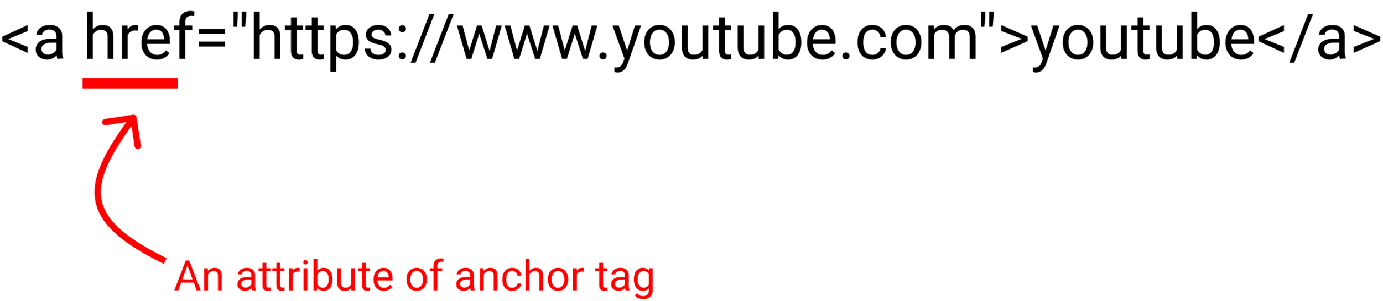
Tags with Attributes
When using some special tags, we need to give attributes to the tag. This concept is from Object-Oriented Programming. Here are some of them:
<a href=“…”> tag defines a hyperlink, which is used to link from one page to another. The <a> stands for anchor.

Slide 13
Tags with Attributes
<img src=”…"> defines an image on the page. Src stands for source.
<input type=“…”> defines an area to take user input. Input of different types look very different in the webpage.
*. The anchor tag, image tag, and input tags don’t have a closing tag. Those tags are called self-closing tags.

Slide 14
Sending HTTP Request Through Python
There are many different ways to send HTTP requests, including web browsers or external software. There’s also one module called requests in Python that allows us to make HTTP requests. We first do:
pip install requests
The request.get(url) sends an HTTP GET request to the URL and returns a Response Object with all the response data (content, encoding, status, etc).
*. There are other different HTTP requests, such as POST, PUT, PATCH, and Delete. Read more about it from https://docs.python-requests.org/en/latest/user/quickstart/.

Slide 15
Sending HTTP Request Through Python
Some information in the Response Object we can get: (if res is the response object)
res.url
res.headers
res.encoding
res.cookies
res.status_code
res.text

Slide 16
Beautiful Soup and lxml
Once we have the HTML file as a string, we can search for the things we need in this string. How do we do it? We can do:
Use a for loop to go through the string and write codes that get the stuff we need from the r.text string. (Requires some programming skills, and a lot of time)
Use a regex to search in the string. (Require some time to write the regex)
Use some external modules to search things for us automatically!
The external module we would use is called Beautiful Soup.

Slide 17
Beautiful Soup and lxml
First, we do:
pip install bs4
pip install lxml
In the terminal.
Beautiful Soup is a Python library for getting data out of HTML and some other markup languages. Lxml is a parser for interpreting the HTML.
The BeautifulSoup(string, parser) method in bs4 module takes a string and one parser as inputs and return a special BeautifulSoup object.

Slide 18
Beautiful Soup and lxml
Some functions to know:
soup.find(name, attribute) - returns a TAG object of the first match. We can search by name or attribute, or both.
soup.find_all(name, attribute) - returns a list of TAG objects.
tag.get(attributeName) - returns the value in that tag’s attribute.
tag.getText() - returns the text part of the HTML tag.
*. The TAG object’s attributes can be accessed by object syntax. For example, <p class=“hello my_P”> TAG object is store in variable h, then we can do print(h[“class”]), we will get [“hello”, “my_P”].

Slide 19
CSS and soup.select()
CSS stands for Cascading Style Sheets. It describes how HTML elements are displayed on the screen, paper, or in other media. The focus of this course is not to make you a web development master; therefore, we won’t talk about any CSS syntax here.
In CSS, there’s CSS Selector syntax to select specific HTML elements, and apply styling on those elements. Here’s some rules:
#someId – will select all HTML elements with id=“someId”
.someClass – will select all HTML elements with class=“someClass”
p.someClass – will select all p tags with class=“someClass”

Slide 20
CSS and soup.select()
Since CSS Selector is widely known, beautiful soup also provides a function that accepts a CSS Selector syntax string and returns a list of TAG that matches the selector.
soup.select(CSSSelector) - returns a list of TAG objects by using CSS Selector syntax.

